Slide 1
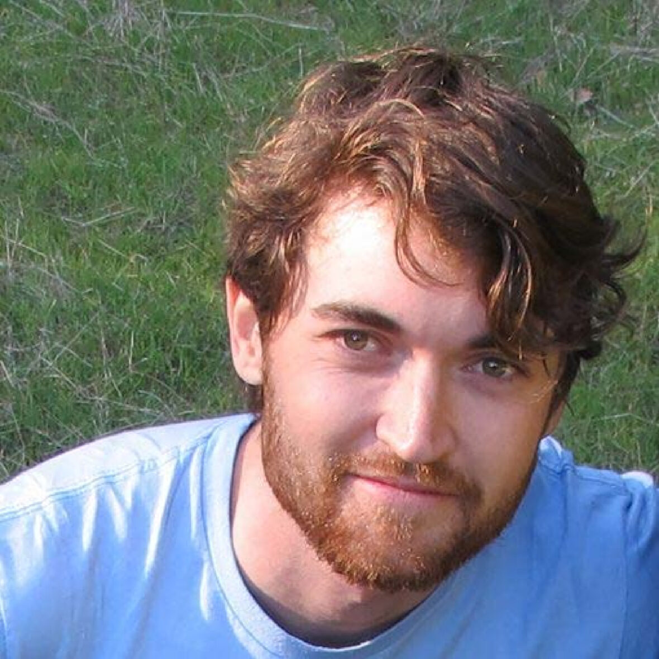

Ross Ulbricht and the Rise, Fall, and Aftermath, of The Silk Road
By: Brendan Thibault
CIS 542

Slide 2

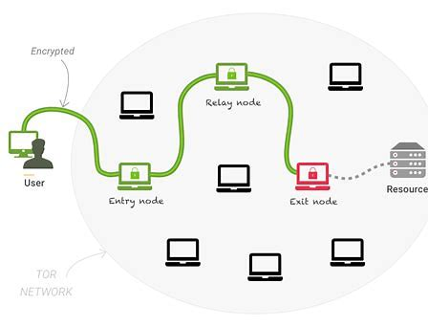
Motivation for this Topic
The Dark Web is a fascinating entity in its own right.
Goal of Tor: “All of the people who have been involved in Tor are united by a common belief: internet users should have private access to an uncensored web.”
How does this complicate our responsibilities as digital forensic examiners when all network traffic is routed through multiple nodes and encrypted throughout?
The history of the Silk Road website is substantial, only able to cover most significant events throughout its history
Was a pioneer in online marketplaces that operated entirely using cryptocurrency, (Bitcoin).
Why is this important? Why not use typical credit card transactions?
Considered highly controversial in the way the FBI handled the case, most notably how they apprehended the suspect.

Slide 3
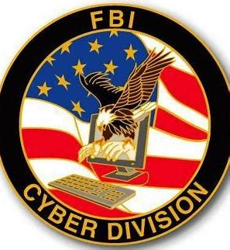
Goal and Scope
Primary goal is to provide an abridged overview of the Silk Road marketplace, highlighting the creation of the site, proliferation of the site, and termination of the site.
Assume the role of a federal digital forensics investigator that is assigned Ross Ulbricht's laptop. (Assuming search warrant was obtained).
Our primary goal as digital forensics investigators is to find circumstantial evidence that Ross Ulbricht participated in, conspired to, etc. criminal acts in relation to the Silk Road.
Specific laptop contents, or tools used to analyze the device were not released to the general public. Consequently, forensics will be performed based on methodology taught in class, with results being what was assumed to be on the device.

Slide 4
History of the Silk Road
Creation of the Site
Ross William Ulbricht was a 29-year-old who had a degree in Physics from University of Texas-Dallas, when he created the Silk Road in 2011.
The Incentivization of the site was to provide an anonymous marketplace, leveraging Tor, that sold paraphernalia, weapons, amongst other illegal items, to anyone willing to pay.
Ulbricht went on numerous clear web sites to promote his newly constructed website, as well as ask questions regarding bitcoin and web development.
Could this be used against him later?
Proliferation of the Site
The site became extremely popular in the years following, attracting thousands of new visitors daily, and well over a million transactions throughout its peak from 2011-2013.
This exposure attracted the attention of the FBI, who were actively pursuing the individual or individual's responsible for this marketplace.

Slide 5

History of the Silk Road (cont.)
Proliferation of the Site (cont.)
Due to OPSEC failure of Ulbricht in leaking his Gmail, FBI was able to corroborate a YouTube channel belonging to him, and a LinkedIn page, in July 2012.
Additionally, they were able to pinpoint his location to a specific area in San Francisco, due to IP header information associated with the Gmail account.
Events transpiring over the next few months leading up to 2013 further reinforced the case that the FBI was building on Ulbricht.
Termination of the Site
On October 1st 2013, FBI agents staged a spousal argument at a café Ulbricht was dining at to distract him from his computer. When he got up to intervene, FBI agents immediately confiscated his laptop and detained him, despite his desperate efforts to close the laptop.
He was sentenced to life imprisonment just 2 years after this incident, for charges related to drug trafficking, computer hacking, money laundering, etc.
He was in possession of over 140,000 bitcoins just on his computer alone, worth about 5.68 Billion USD today!
A significant number of bitcoins were confiscated by the FBI, worth 10’s of billions of USD today.
Site was terminated in 2013, with replicas trying to fill its shadow, but none ever amounted to the success the original had.

Slide 6
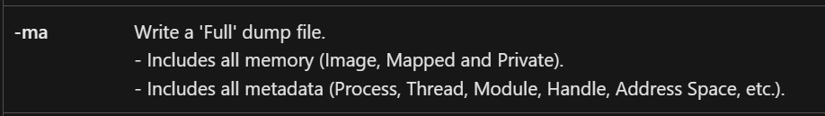
Methods
It was confirmed that a flash drive copied all files from the laptop, and laptop was never turned off.
Our Methodology
Capture memory, (RAM), dump of security process, (lsass.exe), on system that can be used for later investigation
Use data exfiltration capabilities from MimiKatz to extract NTLM hash of all passwords stored in memory dump
Crack hashes using password cracker tool such as hashcat, johntheripper, etc.
Attempt to login to admin panel of Silk Road using cracked passwords, if successful exfiltrate transaction data, account data, chat logs, etc., securely to another hard drive. This would be incriminating evidence on Ulbricht.

Slide 7
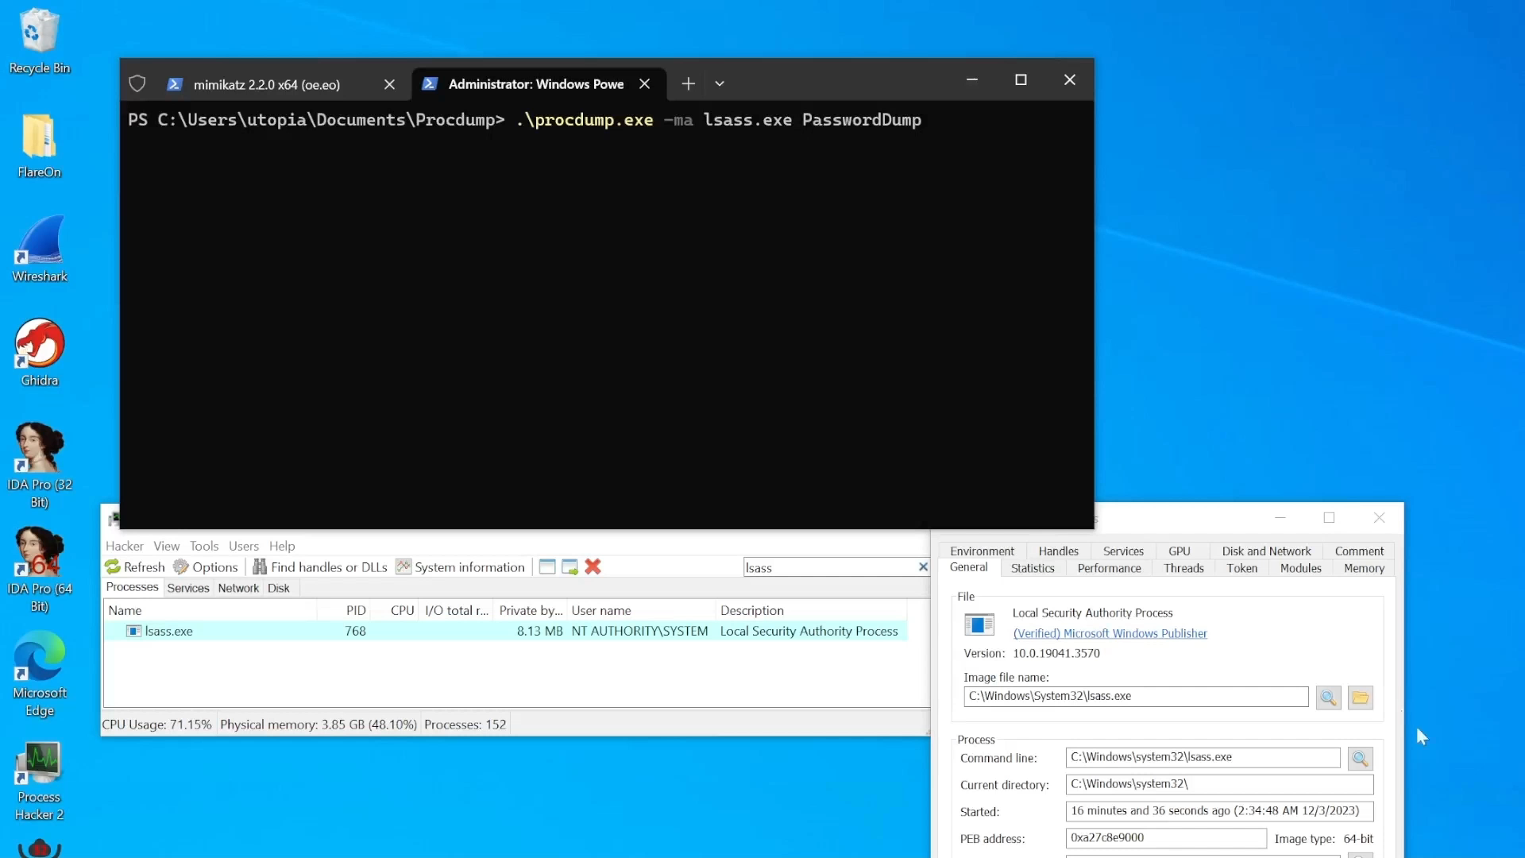
Demo and Results

Slide 8
Sources
How FBI brought down cyber-underworld site Silk Road (usatoday.com)
Drugs, chatlogs, and fake IDs: Images from the Silk Road trial | Ars Technica
Southern District of New York | Ross Ulbricht, The Creator And Owner Of The “Silk Road” Website, Found Guilty In Manhattan Federal Court On All Counts | United States Department of Justice
Ross Ulbricht Will Be Sentenced Soon — Here's How He Was Arrested (businessinsider.com)
Tor Project | History
What the FBI Allegedly Found on Ross Ulbricht's Laptop (businessinsider.com)
Here's What the FBI Found on Ross Ulbricht's Laptop (businessinsider.com)

